Slide 1
How Languages Influence Design
Objects vs. Functions
Harry Pierson
harry.pierson@microsoft.com
http://devhawk.net
@devhawk
Notes:
Normal intro, here’s by contact info, etc.
I sat down to write this talk, long after I had agreed to do it and had submitted an abstract. So I went and read the website to see what I had signed up to do. The abstract sounded familiar, but honestly, I don’t remember picking this title.

Slide 2

Notes:
http://commons.wikimedia.org/wiki/File:Boxing080905_photoshop.jpg

Slide 3
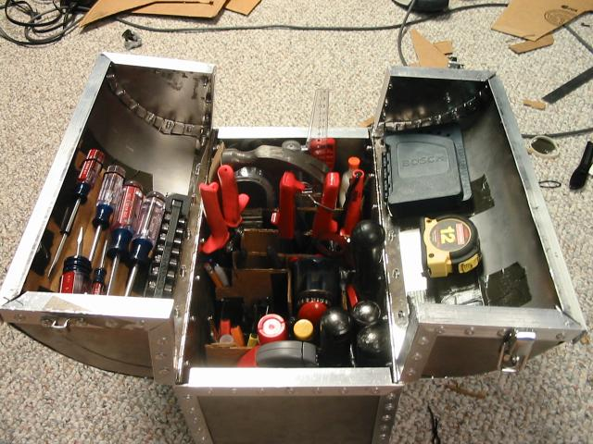
Notes:
http://www.flickr.com/photos/zakh/337938459/
Creative Commons Attribution-Noncommercial-Share Alike 2.0 Generic

Slide 4
A tool’s value is always relative to the problem being solved.

Slide 5
When all you have is a hammer, everything looks like a nail.
OO language
object

Slide 6
Linguistic Determinism
Notes:
Linguistic determinism is the idea that language and its structures limit and determine human knowledge or thought.
linguistic relativity is the idea that the varying cultural concepts and categories inherent in different languages affect the cognitive classification of the experienced world in such a way that speakers of different languages think and behave differently because of it.
Also known as “The Sapir-Whorf hypothesis”
“We cut nature up, organize it into concepts, and ascribe significances as we do, largely because we are parties to an agreement to organize it in this way—an agreement that holds throughout our speech community and is codified in the patterns of our language.”
(Whorf, B. L. (1940): 'Science and Linguistics', Technology Review 42(6): 229-31, 247-8. Also in B. L. Whorf (1956): Language, Thought and Reality (ed. J. B. Carroll). Cambridge, MA: MIT Press)

Slide 7
Linguistic Determinism in Software
Notes:
Linguistic determinism in software is the idea that programming languages and its structures limit and determine software design.
The Pierson-Remy hypothesis?

Slide 8
Objects vs. Functions
and

Slide 9
All programming languages have the same objective.

Slide 10
All programming languages have the same objective.
All programming languages achieve that objective in different ways.

Slide 11
A difference in composition

Slide 12
Object composition vs.
Functional composition
aka Composition of
Things
aka Composition of Actions

Slide 13
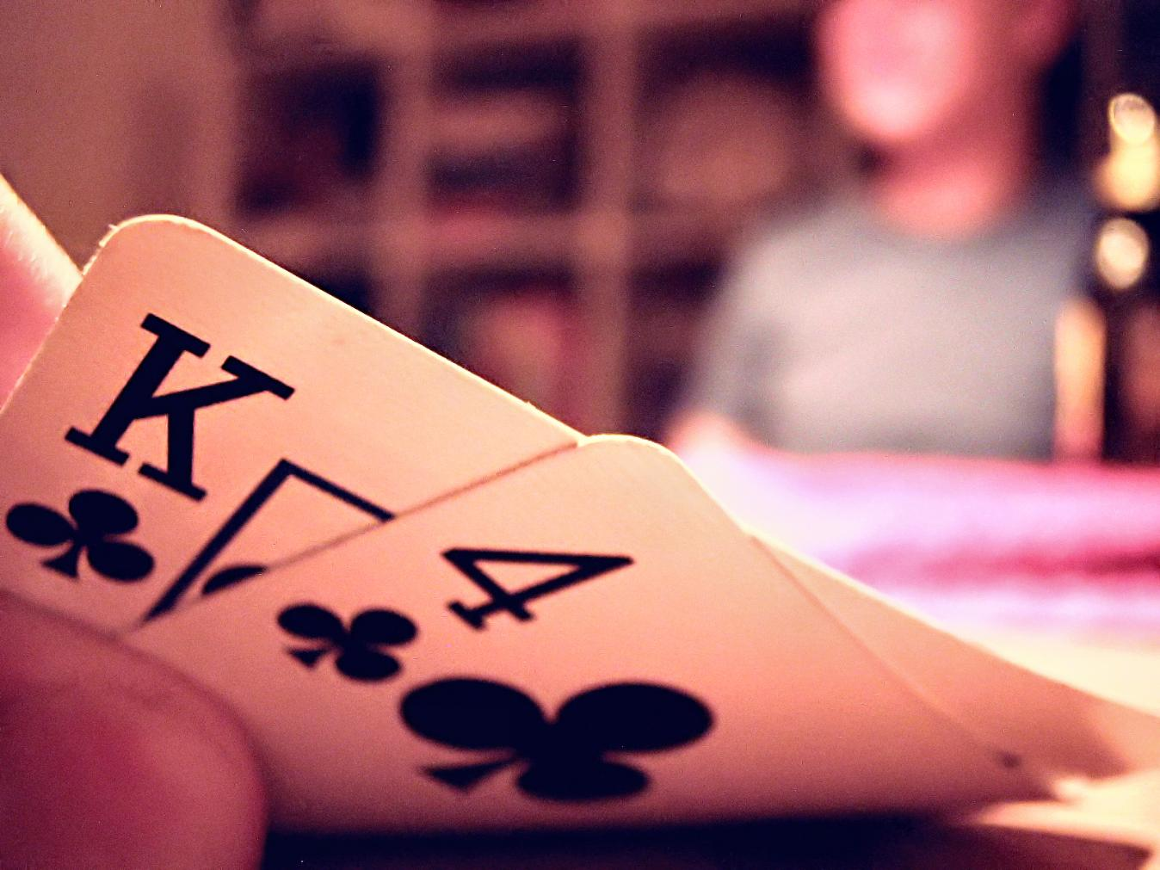
Notes:
http://commons.wikimedia.org/wiki/File:Texas_Hold_%27em_Hole_Cards.jpg
This image is licensed under the Creative Commons Attribution 2.0 Generic License.

Slide 14
5 Card Draw
7 Card Stud
Texas Hold ‘em

Slide 15
Five Card Draw
Ante
Deal 5 each
Betting Round
Showdown
Betting Round
Discard & Draw (up to 3)

Slide 16
Seven Card Stud
Ante
Deal 2 down, 1 up
Betting Round (high card)
Betting Round (high hand)
Deal 1 up
Deal 1 up
Betting Round (high hand)
Showdown
Deal 1 up
Betting Round (high hand)
Deal 1 down
Betting Round (high hand)

Slide 17
Texas Hold ‘em
Blind Bet
Deal 2 Each
Betting Round
Deal Flop
(3 common)
Betting Round
Deal Turn
(1 common)
Betting Round
Deal River
(1 common)
Showdown
Betting Round

Slide 18
Decompose the objects

Slide 19
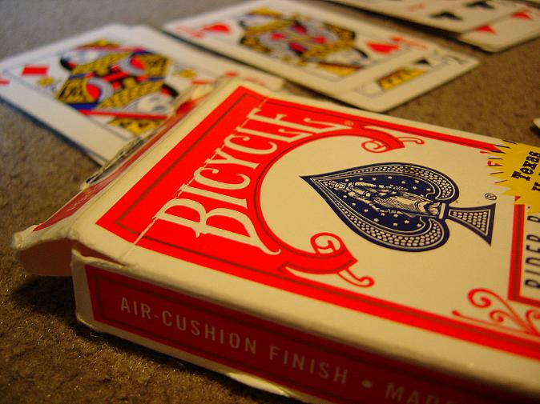
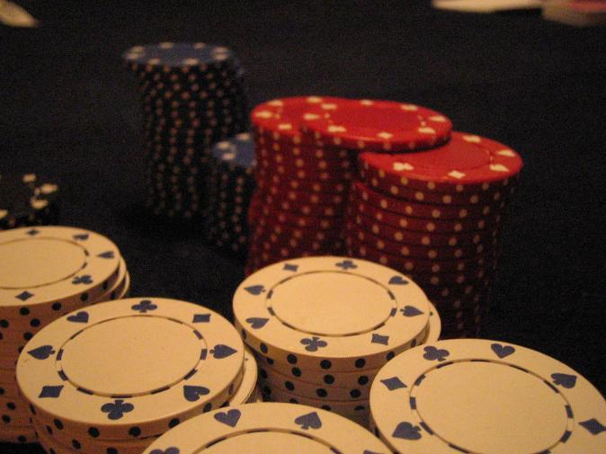
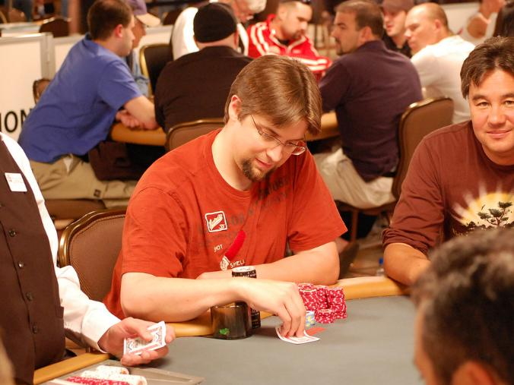
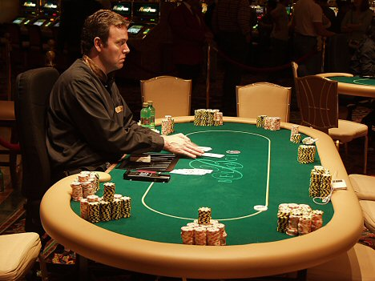
Money
Cards
Table
Players
Notes:
Card Deck: http://www.flickr.com/photos/trekkyandy/271813396/ (This image is licensed under the Creative Commons Attribution-Share Alike 2.0 Generic license)
Chips: http://www.flickr.com/photos/russelljsmith/9487077/ (This image is licensed under the Creative Commons Attribution 2.0 Generic License.)
Players: http://www.flickr.com/photos/runtcake/2581767083/ (This image is licensed under the Creative Commons Attribution 2.0 Generic License. )
Table: http://www.lasvegasvegas.com/viewer/v/WPT2004-2007/WPT2+2004+World+Poker+Tour+5+Diamond+Bellagio/790-lg.jpg.html (This image is licensed under the Creative Commons Attribution-Share Alike 3.0 Unported)

Slide 20
How do these abstractions help us?
they don’t…

Slide 21
Decompose the objects
actions

Slide 22
class CommonPokerFunctions
{
static PokerGame Ante(this List<Players>, int)
static PokerGame Deal(this PokerGame, int, facing)
static PokerGame Bet(this PokerGame, Func<player>)
static PokerGame Burn(this PokerGame, Func<player>)
static PokerGame Showdown(this PokerGame)
}

Slide 23
players
.Ante(10)
.Deal(2, Down).Deal(1, Up)
.Bet(() => high up card)
.Burn(1).Deal(1, Up).Bet(() => high up hand)
.Burn(1).Deal(1, Up).Bet(() => high up hand)
.Burn(1).Deal(1, Up).Bet(() => high up hand)
.Burn(1).Deal(1, Down).Bet(() => high up hand)
.ShowDown()

Slide 24
class FiveCardDraw
{
static PokerGame Draw(this PokerGame, int)
}
class TexasHoldEm
{
static PokerGame DealCommunity(this PokerGame, int)
}

Slide 25
players
.Ante(10)
.Deal(5, Down)
.Bet(() => player left of dealer)
.Burn(1)
.Draw(3)
.Bet(() => player left of dealer)
.ShowDown()

Slide 26
players
.BlindBet(_amount)
.Deal(2, Down)
.Bet(() => player left of big blind)
.Burn(1)
.DealCommunity(3) //Flop
.Bet(() => player left of dealer)
.Burn(1)
.DealCommunity(1) //Turn
.Bet(() => player left of dealer)
.Burn(1)
.DealCommunity(1) //River
.Bet(() => player left of dealer)
.ShowDown()

Slide 27
LINQ
functional constructs
"you got peanut butter
in my chocolate”
OO language
Notes:
Functional programming in C#

Slide 28
How Languages Influence Design
Objects vs. Functions
Paradigms
and
Harry Pierson
harry.pierson@microsoft.com
http://devhawk.net
@devhawk

Slide 29
! Everything == new Nail()
Harry Pierson
harry.pierson@microsoft.com
http://devhawk.net
@devhawk

Slide 30
“A language that doesn't affect the way you think about programming is not worth knowing.”
Alan Perlis

